Slide 1
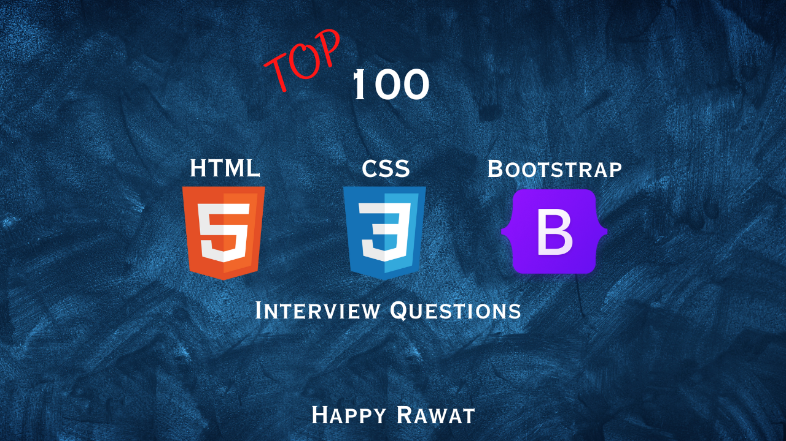

Slide 2

PREFACE
ABOUT THE BOOK
This book contains 200 very important JavaScript interview questions.
ABOUT THE AUTHOR
Happy Rawat has around 15 years of experience in software development. He helps candidates in clearing technical interview in tech companies.

Slide 3

Top 100 HTML, CSS, Bootstrap Interview Q&A
Bootstrap
1. Bootstrap
HTML
1. Basics & Document Structure
2. HTML Elements & Tags – Part I
3. HTML Elements & Tags – Part II
4. HTML Attributes
5. HTML Links & Navigation
6. HTML Lists & Tables
7. HTML Images & Multimedia
8. HTML Forms
9. Best Practices & Deployment
10. Responsiveness & Others
CSS
1. Basics & Implementation
2. Selectors in CSS
3. Layout and Positioning
4. Responsive Design

Slide 4
1. HTML Basics & Document Structure
Q. What is HTML? Differences between HTML & HTML5? Advantages of HTML5?
Q. What is the difference between HTML and XHTML?
Q. What is the role of DOCTYPE in HTML?
Q. What if you remove <!DOCTYPE html> from your HTML?
Q. Difference between Head & Body in HTML? Where to place JS link reference?
Q. What is Title Tag in HTML? What are the 4 advantages of Title tag?
Q. What are Meta Tags? What are the 5 types of meta tags?
Back to main index

Slide 5

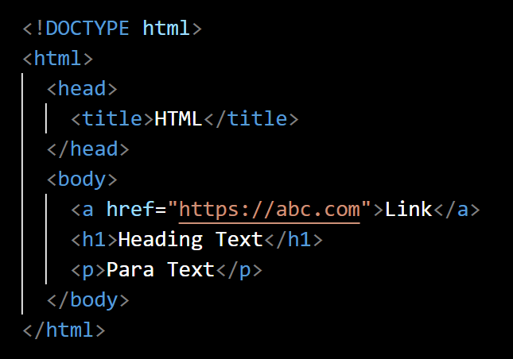
Q. What is HTML? Differences between HTML & HTML5? Advantages of HTML5?
HTML(HyperText Markup Language) is the standard markup language used to create web pages.
Markup language meaning a language which define the structure of a document using elements like headings, paragraphs, links, lists, and more.
HTML is not a programming language, it’s a markup language like XML.
Hyper
Text
Markup
Language
back to chapter index

Slide 6
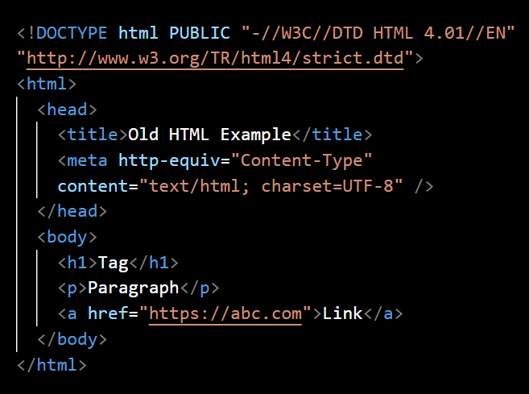
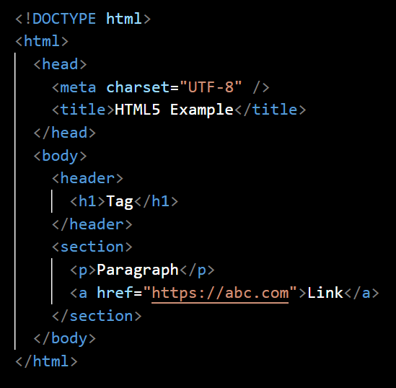
Q. What is HTML? Differences between HTML & HTML5? Advantages of HTML5?
HTML5 is the fifth and latest version of HTML.
Old HTML/ HTML4
HTML/ HTML5
back to chapter index

Slide 7
Q. What is HTML? Differences between HTML & HTML5? Advantages of HTML5?
5 Advantages of HTML5:
1. New Semantic Elements: <header>, <nav>, <article>, <section>, <aside>, <footer>
2. Form Input Types: <input type="date">, <input type="email">
3. Audio and Video Support: <audio>, <video>
4. Mobile Compatibility
5. Simpler Code
back to chapter index

Slide 8
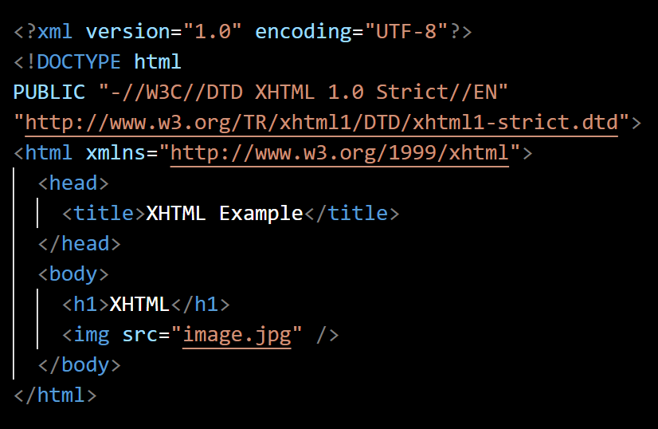
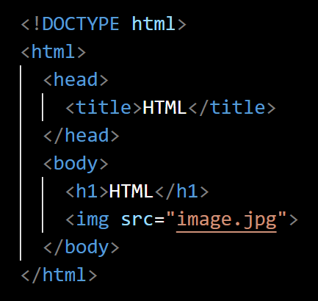
Q. What is the difference between HTML and XHTML?
XHTML(eXtensible HyperText Markup Language) is a markup language that follows the rules of XML to define the structure of web pages.
XHTML
HTML/ HTML5
back to chapter index

Slide 9
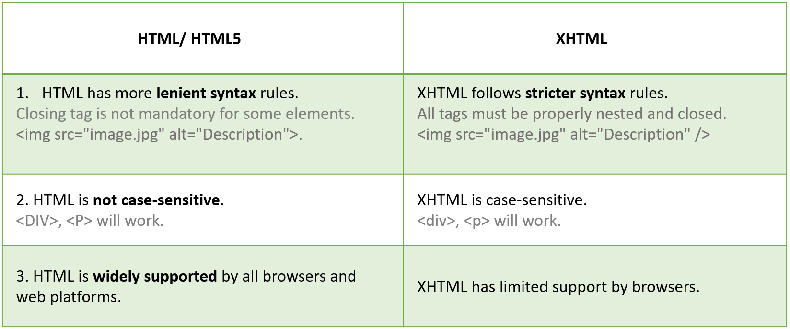
Q. What is the difference between HTML and XHTML?
back to chapter index

Slide 10
Q. What is the difference between HTML and XHTML?
HTML/ HTML5 | XHTML
HTML has more lenient syntax rules. Closing tag is not mandatory for some elements. <img src="image.jpg" alt="Description">. | XHTML follows stricter syntax rules. All tags must be properly nested and closed. <img src="image.jpg" alt="Description" />
2. HTML is not case-sensitive. <DIV>, <P> will work. | XHTML is case-sensitive. <div>, <p> will work.
3. HTML is widely supported by all browsers and web platforms. | XHTML has limited support by browsers.
back to chapter index

Slide 11
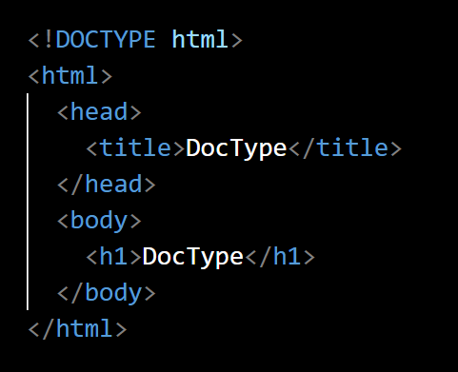
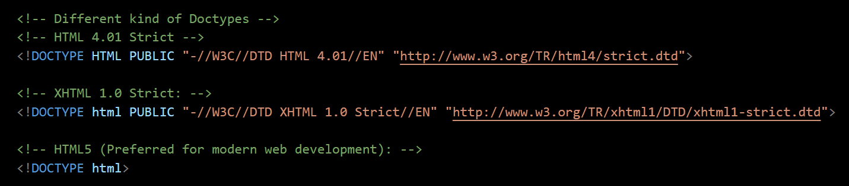
Q. What is the role of DOCTYPE in HTML?
DOCTYPE(Document Type) declaration specifies the version of HTML.
DOCTYPE tells the browser which version of HTML it is and how to interpret the code.
back to chapter index

Slide 12

Q. What if you remove <!DOCTYPE html> from your HTML?
Then browsers can still render the page, but they will not be able to validate the version of HTML, therefore it may lead to some compatibility issues with SEO or debugging.
back to chapter index

Slide 13
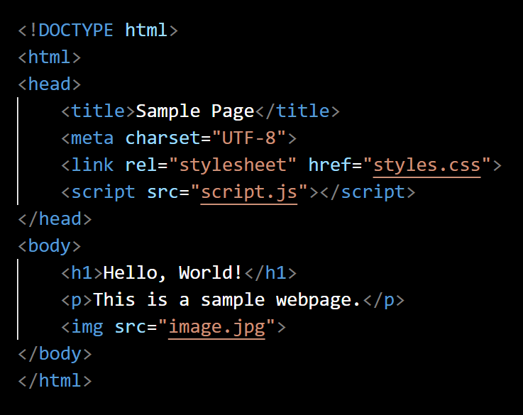
Q. Difference between Head & Body in HTML? Where to place JS link reference?
The <head> element is where you place meta-information (information about the document ). For example, <title>, <meta>, <link>, <script>, <style> are normally kept under head element.
The <body> element is where you place the actual content of your HTML web page. For example, <div>, <h1>, <p>, <img>, <a> are normally kept under body element.
Head will load before the body, therefore, if you are manipulating HTML elements in your JS functions, then place the JS link at the end of the body section because until then all the elements will be loaded. Else, place it inside the head tag.
back to chapter index

Slide 14
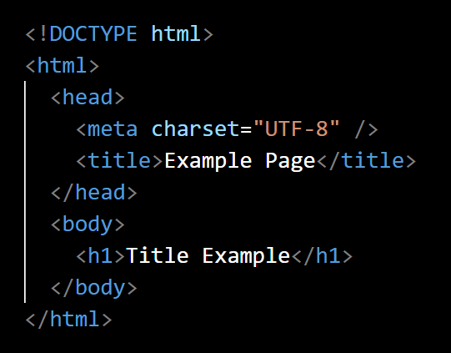
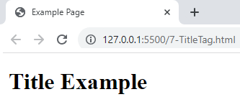
Q. What is Title Tag in HTML? What are the 4 advantages of Title tag?
The <title> tag in HTML is used to define the title of a web page.
back to chapter index

Slide 15
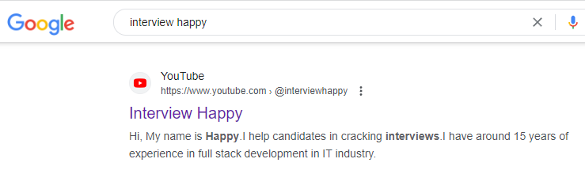
Q. What is Title Tag in HTML? What are the 4 advantages of Title tag?
Advantages of title tag:
Window Title: <title> element text is displayed in the tab of the browser.
SEO: Search engines use the title as the main heading for search results.
Bookmarks/Favorite: Title tag is used as the default name for the bookmark.
Social Media Sharing: Title tag is used as the default title in the shared post.
back to chapter index

Slide 16
Q. What are Meta Tags? What are the 5 types of meta tags?
Meta tags in HTML are elements used to provide metadata or additional information about a web page.
5 Types of Meta Tags
1. charset
2. viewport
3. description
4. keywords
5. author
back to chapter index

Slide 17
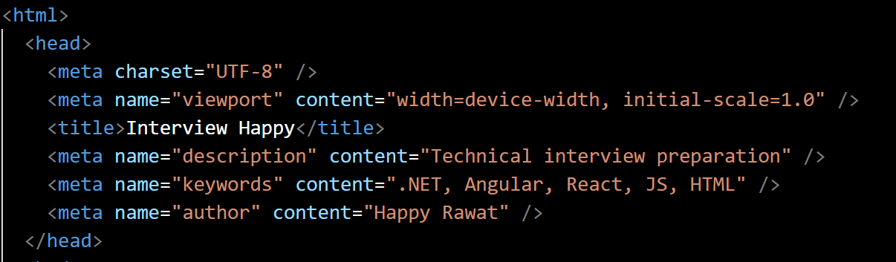
Q. What are Meta Tags? What are the 5 types of meta tags?
1. Character Encoding:
This helps browsers to interpret the different characters in the document. The charset="UTF-8" attribute ensures that characters from different languages will be displayed correctly in the browser.
2. Responsive Design:
viewport meta tag is crucial for creating mobile-friendly, responsive web designs for various screen sizes.
3. Description for SEO:
This meta tag provides description of the content of the page. Search engines may use this for search results.
4. Keywords for SEO:
This meta tag used to be important for search engines, but it's now of less importance.
5. Author Info:
This meta tag can be used to specify the author of the document.
back to chapter index

Slide 18
2. HTML Elements & Tags – Part I
Q. What are HTML Elements? What is the difference between Element & Tag?
Q. What are the roles and uses of the <div> element in HTML?
Q. What is the difference between <div> and <span> element?
Q. What is the role of <p>, <a>, <br>, <hr>, <em>, <img>, <input> & <button> elements?
Q. What is the role of header, main, section, footer & address elements in HTML?
Q. What is the role of Heading tags in HTML? How does it impact SEO?
Q. What is the difference between <section> & <article> elements?
Back to main index

Slide 19
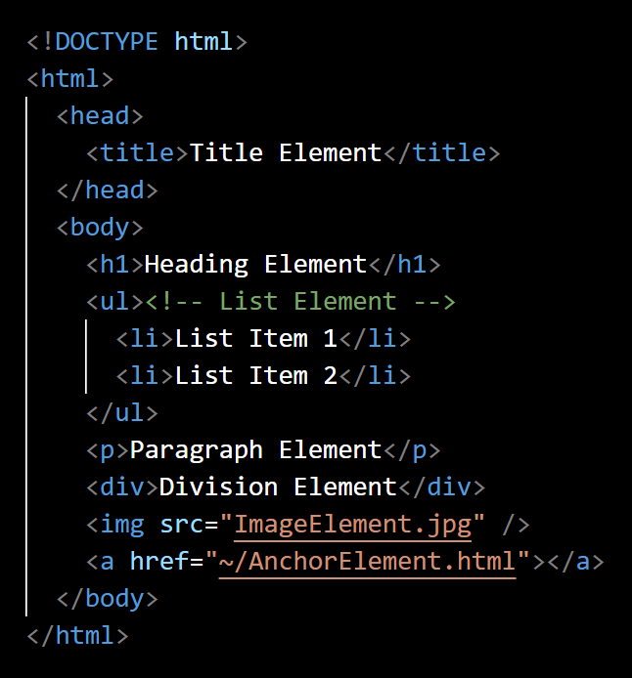

Q. What are HTML elements? What is the difference between Element & Tag?
HTML elements are the building blocks of web pages.
Element consists of a start tag, content, and an end tag.
Tag is a specific part of an element that denotes the beginning or end of that element.
Opening Tag
Closing Tag
Content/ Text
HTML Element
back to chapter index

Slide 20
Q. What are HTML elements? What is the difference between Element & Tag?
Top 10 most common used HTML elements
1. Paragraph Element: Defines a block of text.<p>.
2. Heading Elements: <h1> <h2><h3><h4><h5><h6>.
3. Header and Footer Elements: <header> and <footer>.
4. Sectioning Elements: <section>, <article>, <nav>, <aside>, <main>.
5. Image Element: Embeds images into a webpage.<img> (self-closing).
6. List Elements: <ul> (unordered list), <ol> (ordered list) ), <li> (list item).
7. Anchor Element (Link): Creates hyperlinks to other pages or resources.<a>.
8. Division Element: <div> groups together content for applying styles or scripting.<div>.
9. Table Elements: <table>, <tr> (table row), <th> (table header) and <td> (table data).
10. Form Elements: Used for creating forms.<form>, <input>, <button>, <select>, <textarea>, etc.
back to chapter index

Slide 21
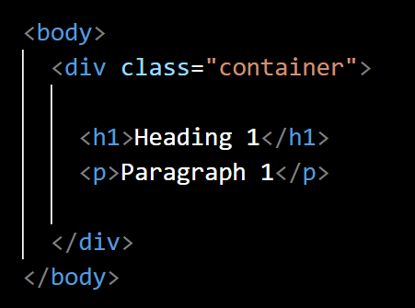
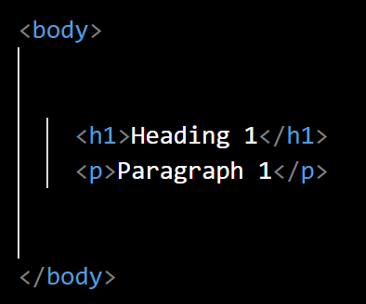
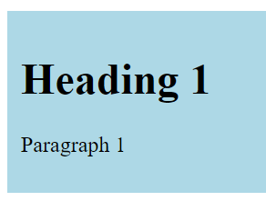
Q. What are the roles and uses of the <div> element in HTML?
The <div>(division) element in HTML is a container that is used to group and structure the content on a webpage.
Top 3 uses of <div> element:
1. Grouping & structuring Content:
2. Styling and Layout:
3. Scripting:
It allows you to group together related elements.
<div> elements are used to apply common styles or css to grouped elements.
JavaScript and other scripting languages can target <div> elements to manipulate their content or behavior.
back to chapter index

Slide 22
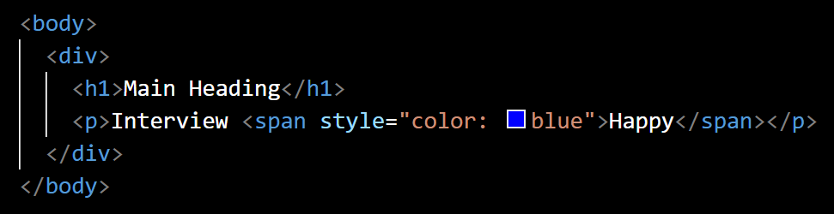
Q. What is the difference between <div> and <span> element?
The <div>(division) element in HTML is a container that is used to group and structure the content on a webpage.
The <span> element in HTML is an inline container used to apply styles or scripting to a specific section of text or content.
<div> is a block-level element and <span> is an inline element.
back to chapter index

Slide 23
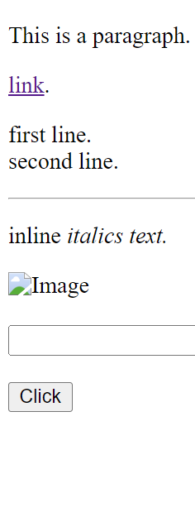
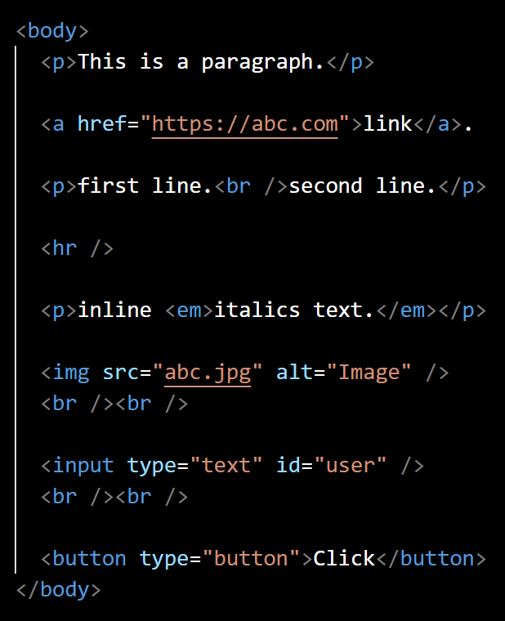
Q. What is the role of <p>, <a>, <br>, <hr>, <em>, <img>, <input> & <button> elements?
1. <p>
2. <a>
3. <br>
Defines a paragraph of text.
Creates a hyperlink. The href attribute specifies the url and content is the text of hyperlink.
Inserts a line break.
4. <hr>
Creates a horizontal line break.
back to chapter index

Slide 24
Q. What is the role of <p>, <a>, <br>, <hr>, <em>, <img>, <input> & <button> elements?
1. <em>
2. <img>
3. <input>
Emphasizes text displayed in italics.
Embeds an image. The src attribute specifies the image file, and alt provides alternative text.
Creates an input field within a form.
4. <button>
Creates a clickable button.
back to chapter index

Slide 25
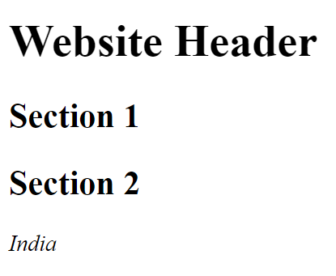
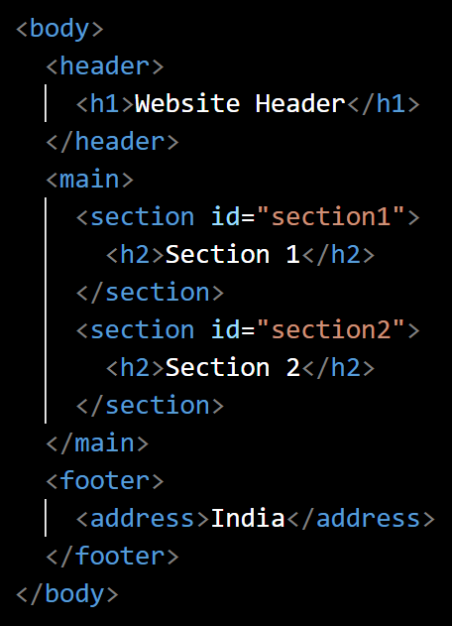
Q. What is the role of header, main, section, footer & address elements in HTML?
<header>, <main>, <section> and <footer> are semantic elements, used to define the layout and structure of a webpage in a meaningful and organized way.
<header>
<main>
<footer>
Contains the header content of website.
Contains the main content of the document.
contains the group related content.
<address>
provides contact information.
back to chapter index

Slide 26


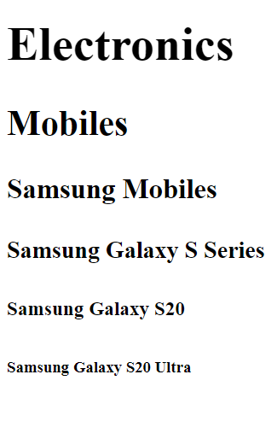
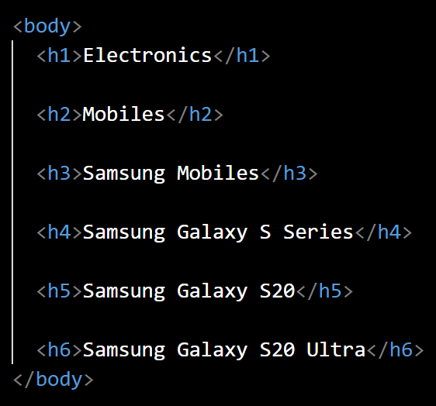
Q. What is the role of Heading tags in HTML? How does it impact SEO?
Heading tags in HTML are used to define the headings of sections within a webpage.
Top 3 uses of heading tags:
Organization & Readability: Heading tags organize the content in better way, making it easier for users to understand the organization of the page.
SEO (Search Engine Optimization): Search engines use headings to understand the importance of content.
Styling and Layout: For example, same CSS can be applied to all h1 tags to show their importance. That will help in creating consistent layouts.
back to chapter index

Slide 27
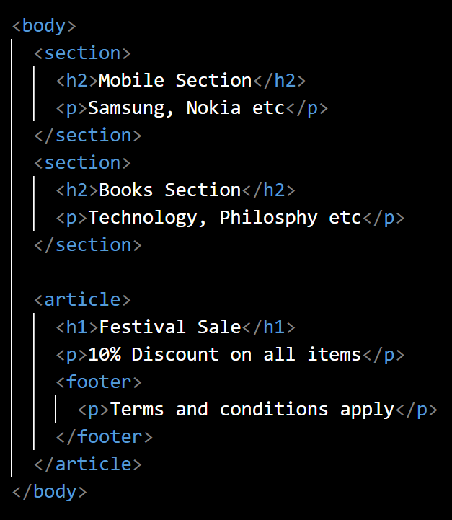

Q. What is the difference between <section> & <article> elements?
The <section> element is a generic container used to group related content together.
The <article> element represents a self-contained or independent piece of content with a title and content. For example: a blog post, a news article, a forum post, a comment, etc.
Article example: offer
back to chapter index

Slide 28
3. HTML Elements & Tags – Part II
Q. What are Root, Parent, Child & Nested elements?
Q. What are Empty Elements?
Q. What are Semantic Elements in HTML?
Q. Can HTML tags be written in Uppercase?
Q. What are the 3 differences between Block-Level & Inline Elements?
Q. List all Block-Level & Inline Elements in HTML.
Back to main index

Slide 29
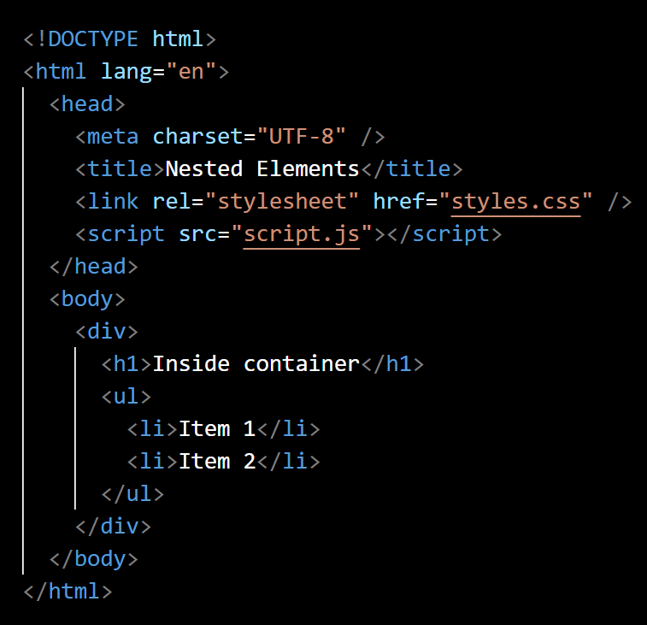
Q. What are Root, Parent, Child & Nested elements?
<html>(Root)
<head>(Parent)
<body>(Parent)
<meta>(child)
<div>(Parent for h1 & ul)
(Child/ Nested for body)
<title>(child)
<h1>
<link>(child)
<script>(child)
<ul>
<li>
<li>
back to chapter index

Slide 30
Q. What are Root, Parent, Child & Nested elements?
The root element is the highest-level element in the hierarchy of an HTML document. In HTML5, the root element is <html>.
A parent element is an element that contains other child elements.
A child or nested element is an element that is contained within a parent element. Child and nested elements are same.
back to chapter index

Slide 31
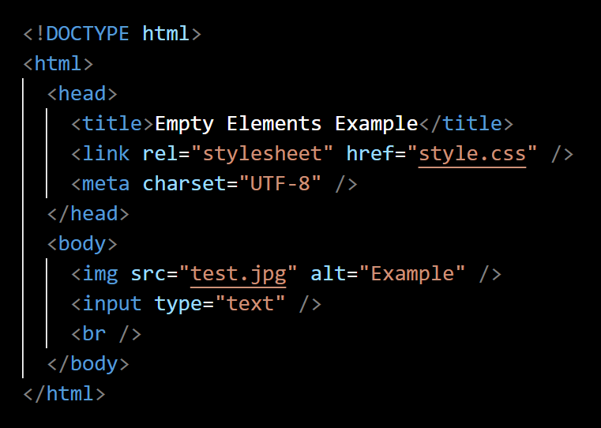
Q. What are Empty Elements?
An empty element in HTML is an element that doesn't need content between opening and closing tags.
Empty elements are also called a self-closing or void elements.
Empty elements in HTML: <img>, <input>, <br>, <hr>, <meta>, <link>, <area>, <base>, <col>, <embed>.
back to chapter index

Slide 32
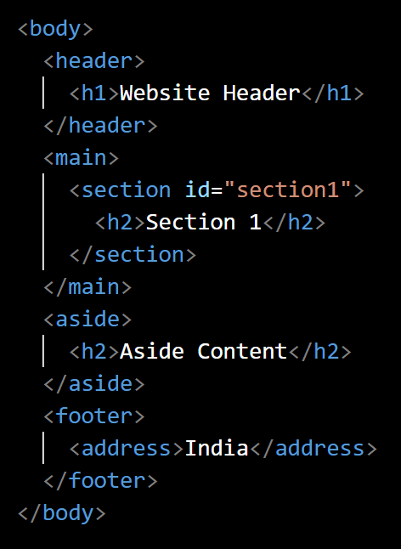
Q. What are Semantic Elements in HTML? Is div a semantic element?
Semantic elements in HTML are elements that provide meaning to the content they contain.
<div> is not a semantic element, because div is a general-purpose structural element. It doesn’t give any meaning to the content.
Top 5 Semantic elements
1. <header>
2. <main>
3. <section>
4. <footer>
5. <address>
back to chapter index

Slide 33
Q. What are Semantic Elements in HTML? Is div a semantic element?
10 more semantic elements:
<progress> - Displays the progress of a task.
<nav> - Contains navigation links for a webpage.
<time> - Represents a specific period in time or a date.
<mark> - Highlights parts of the text for reference or emphasis.
<summary> - Provides a summary, caption, or legend for a <details> element.
<meter> - Represents a scalar measurement within a known range (like a gauge).
<figure> - Contains content like images, illustrations, diagrams, etc., along with a caption.
<details> - Represents additional information or controls that can be toggled open or closed.
<aside> - Contains content that is related to the main content but can be considered separate.
<article> - Represents a self-contained composition in a document, such as a blog post or a news article.
back to chapter index

Slide 34
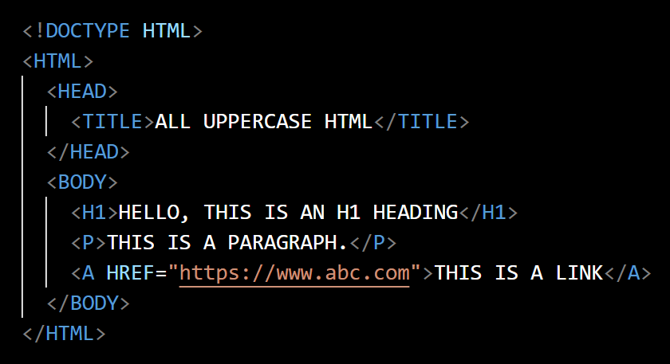
Q. Can HTML tags be written in Uppercase?
Yes, HTML tags not case-sensitive therefore can be written in uppercase, lowercase, or a combination of both.
But it is not recommended as per standards.
back to chapter index

Slide 35
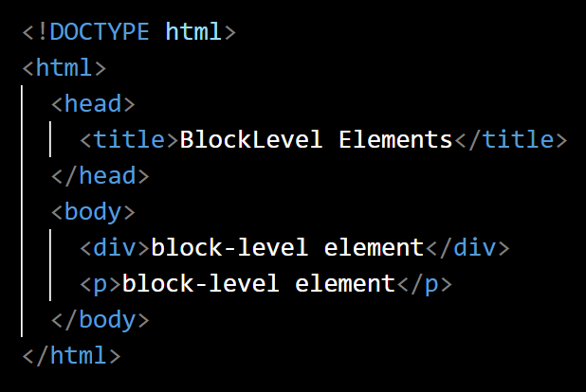
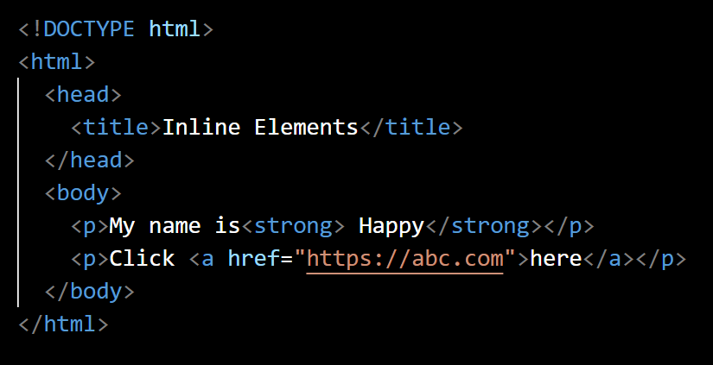
Q. What are the 3 differences between Block-Level and Inline Elements?
Block-level elements create "blocks" of content. <div>, <p>, <h1>, <ul>, <li>, <table>, <form> etc.
By default, Block-level elements start on a new line.
You can set both width and height for block-level elements.
Inline elements length depends on their content length. <span>, <a>, <strong>, <em>, <img>, <input>, <br> etc.
Inline elements do not start on a new line.
You can't set width and height for inline elements.
back to chapter index

Slide 36
Q. List all Block-Level & Inline elements in HTML.
Top 20 block-level elements in HTML:
<h1>, <h2>, <h3>, <h4>, <h5>, <h6>: Heading elements from highest (h1) to lowest (h6) level.
<header>: Represents the introductory content or a group of navigational links.
<div>: The generic container element used for grouping and applying styles.
<footer>: Represents the footer of a section or document.
<nav>: Defines a section with navigation links.
<section>: Defines a section of a document.
<ol>: Creates an ordered (numbered) list.
<p>: Represents a paragraph of text.
<li>: Represents a list item in a list.
<ul>: Creates an unordered list.
back to chapter index

Slide 37
Q. List all Block-Level & Inline elements in HTML.
Top 20 block-level elements in HTML(Continued…):
<article>: Represents a self-contained piece of content, such as a blog post or article.
<aside>: Represents content related to the main content but is considered separate.
<blockquote>: Represents a section that is quoted from another source.
<figure>: Used for encapsulating media and its caption.
<form>: Used for creating forms to collect user input.
<hr>: Creates a horizontal rule (a thematic break).
<figcaption>: Represents a caption for a <figure>.
<table>: Defines structure of a table.
<tr>: Represents a table row.
<td>: Represents a table cell.
back to chapter index

Slide 38
Q. List all Block-Level & Inline elements in HTML.
Top 20 inline elements in HTML:
<span>: A generic container that doesn't have any specific semantic meaning.
<strong>: Indicates strong importance, often displayed as bold text.
<span>: A generic container used for applying styles or scripting.
<em>: Emphasizes on text, often displayed as italicized text.
<small>: Reduces the text size, often used for fine print.
<a>: Creates hyperlinks to other pages or resources.
<label>: Provides a label for an input element.
<input>: Used to create form input fields.
<code>: Represents a snippet of code.
<cite>: Specifies the title of a work.
back to chapter index

Slide 39
Q. List all Block-Level & Inline elements in HTML.
Top 20 inline elements in HTML(Continued…):
<br>: Inserts a line break, forcing content after it onto a new line.
<select>: Creates a dropdown menu for selecting options.
<time>: Represents a specific period in time or a date.
<small>: Reduces the text size, used for fine print.
<abbr>: Defines an abbreviation or acronym.
<del>: Indicates deleted or removed text.
<q>: Defines a short inline quotation.
<sup>: Renders text as superscript.
<sub>: Renders text as subscript.
<img>: Embeds an image.
back to chapter index

Slide 40
4. HTML Attributes
Q. What are HTML Attributes? What are the Types of HTML attributes?
Q. What are the Id, Style & Class attributes of an element? When to use what?
Q. What will happen if two elements have same ids?
Q. How to specify Multiple Classes for single element? What is the style precedence?
Q. What are Data Attributes in HTML?
Back to main index

Slide 41
Q. What are HTML Attributes? What are the Types of HTML attributes?
HTML attributes provide additional information about HTML elements.
HTML Attributes
Content/ Text
Opening Tag
HTML Element
Closing Tag
back to chapter index

Slide 42
Q. What are HTML Attributes? What are the Types of HTML attributes?
Types of attributes:
1. Common Attributes (Global Attributes)
2. Specific Attributes
Example: class, id, style, data-*
Example: href, src, alt, width, height, target, rel, type, value, name, placeholder, disabled, readonly, checked, selected
They are common and applicable for all the elements.
These are specific to the elements.
back to chapter index

Slide 43
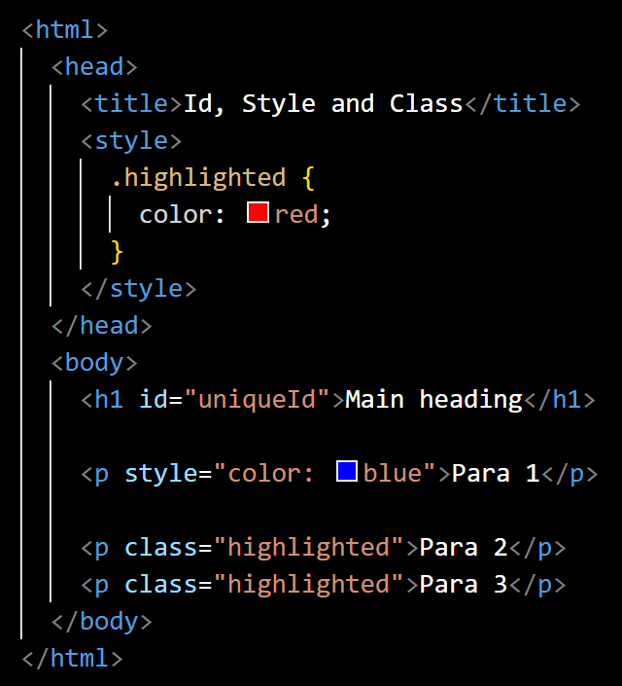
Q. What are the Id, Style & Class attributes of an element? When to use what?
id attribute is used to uniquely identify an element on a page.
The primary purpose of the id attribute is to allow JavaScript and CSS to target and manipulate specific elements.
style attribute allows you to apply inline styles directly to an individual element.
class attribute is used to group together multiple elements that share common styles.
classes are recommended for large website not inline styles.
back to chapter index

Slide 44
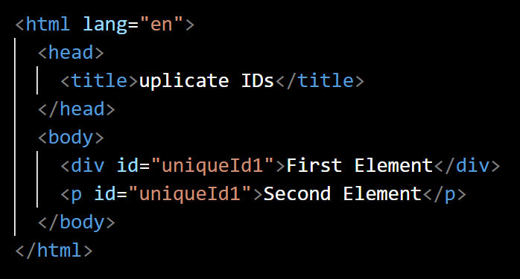
Q. What will happen if two elements have same ids?
May be in browser there is no direct impact, but it will be considered as invalid HTML.
Invalid HTML means it can lead to unexpected behavior in your webpage. For example, problems can occur in css styling and JavaScript interactions.
back to chapter index

Slide 45
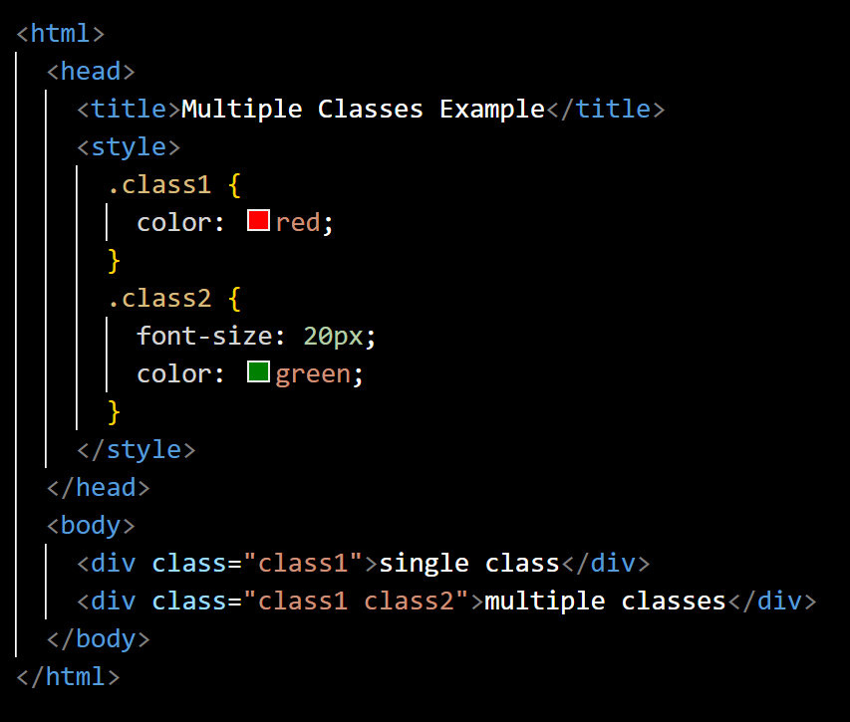
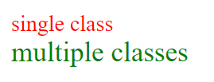
Q. How to specify Multiple Classes for single element? What is the style precedence?
To specify multiple classes for an element in HTML, you can simply add a space-separated list of class names within the class attribute.
In case of multiple classes with same style attribute, style defined in the last class will take precedence.
back to chapter index

Slide 46
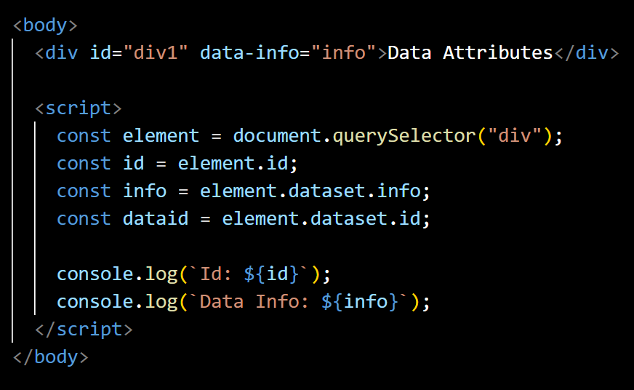
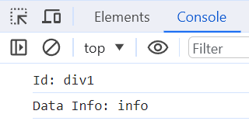
Q. What are Data Attributes in HTML?
Data attributes in HTML provide a way to add custom data attributes to add additional informational in elements.
Data attributes are specified using the data- prefix.
Data attributes can be accessed by dataset property in JS.
back to chapter index

Slide 47
5. HTML Links & Navigation
Q. What are the 5 Types of Links in HTML?
Q. What is the difference between Absolute & Relative URLs?
Q. What is the purpose of the <nav> element in HTML?
Q. What is a Fragment Identifier in a URL?
Q. What is the purpose of the <base> element in HTML.?
Q. How do you add an external stylesheet in your HTML?
Q. How do you open a link in a new tab?
Q. How do you create an Email Link?
Back to main index

Slide 48
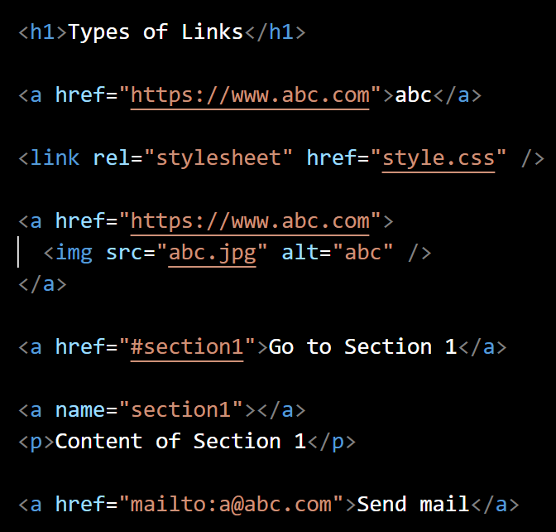
Q. What are the 5 Types of Links in HTML?
5 Types of Link elements
Anchor Link
External Resource Link
Image Link
Bookmark Link
(Named Anchor)
Email Link
Anchor Link (<a>) used for navigating from one webpage to another.
External Resource Link (<link>) used in the <head> section to connect to an external resource like a stylesheet or an icon.
Image Link (<img>) used to create a clickable image that leads to another webpage.
Bookmark Link (Named Anchor) points to a specific location within a webpage using a named anchor.
Email Link creates a clickable link that opens the user's default email client with a pre-filled email address.
back to chapter index

Slide 49
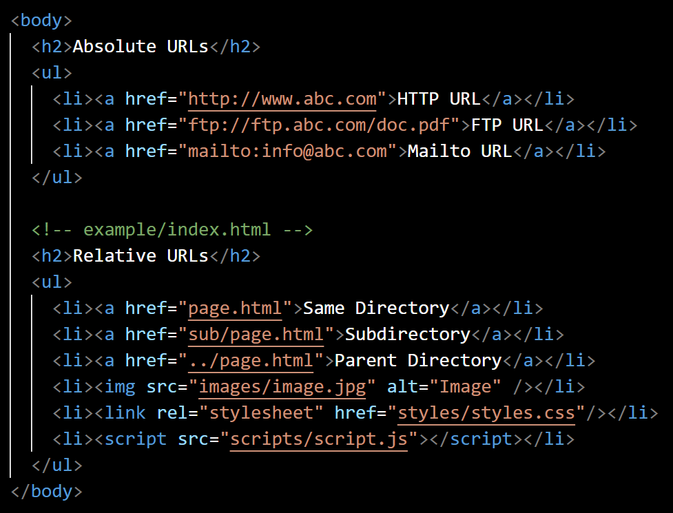
Q. What is the difference between Absolute and Relative URLs?
Absolute URLs:
Absolute URLs provide the complete web address of a resource.
Absolute URLs are typically used to link to resources on different websites.
Relative URLs:
Relative URLs specify the location of a resource in relation to the current document. Full url is not required.
They are used when linking to resources within the same website.
back to chapter index

Slide 50
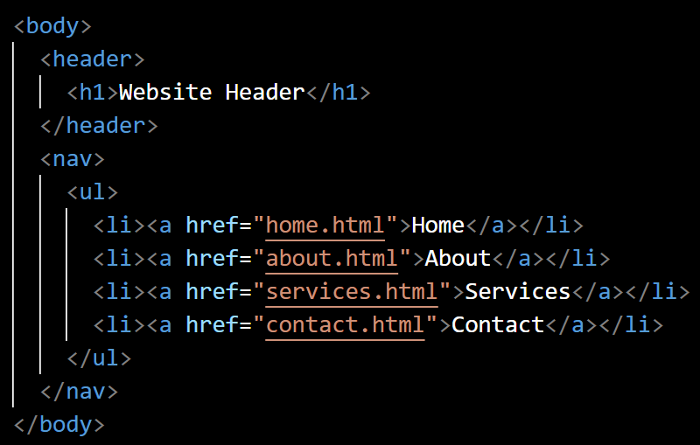
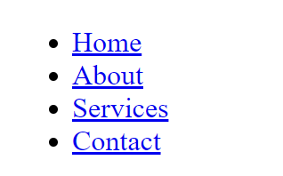
Q. What is the purpose of the <nav> element in HTML?
<nav> element in HTML is used to define a section of a web page that contains navigation links.
<nav> element provide clear navigation structure and keep navigation separate from other body content which is good from SEO perspective.
back to chapter index

Slide 51
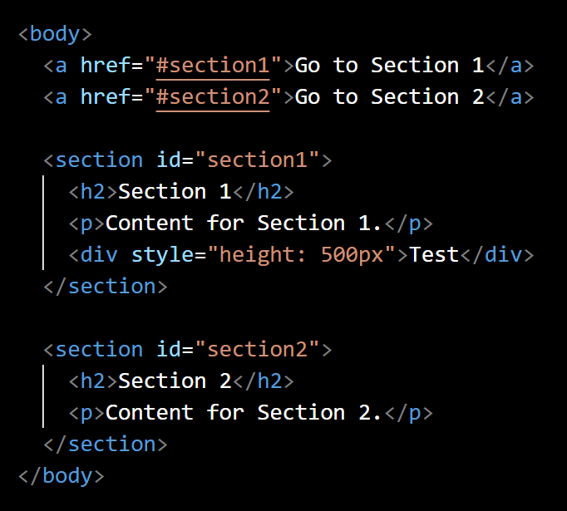
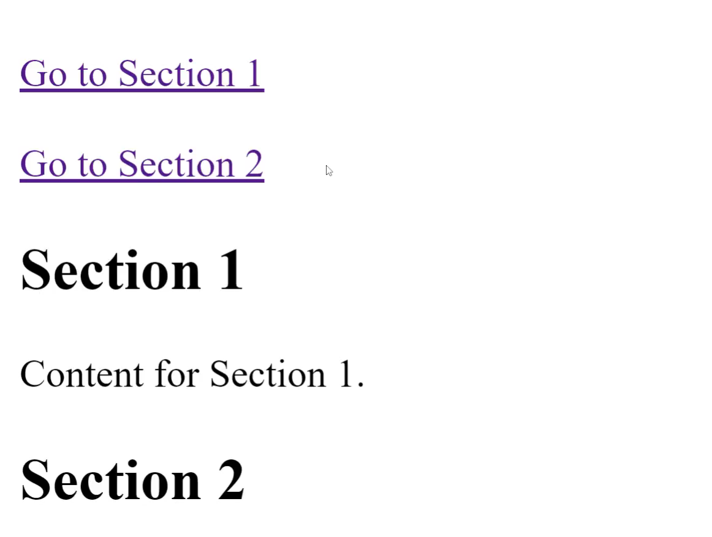
Q. What is a Fragment Identifier in a URL?
A fragment identifier is used to navigate to a specific section of the same webpage.
Fragment identifier is preceded by a # (hash) symbol.
back to chapter index

Slide 52
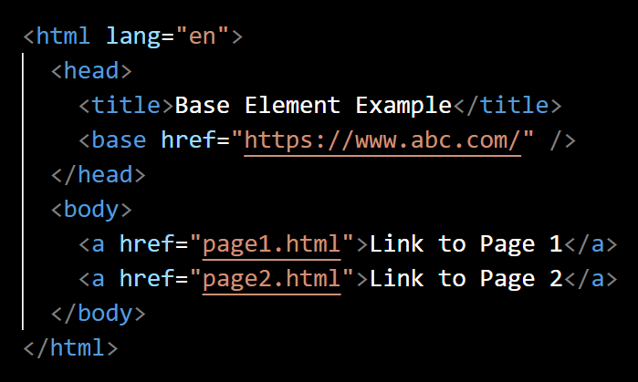
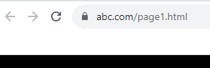
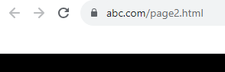
Q. What is the purpose of the <base> element in HTML.?
The <base> element in HTML is used to specify a base URL for relative URLs within a document.
The <base> element is typically placed within the <head> section.
back to chapter index

Slide 53
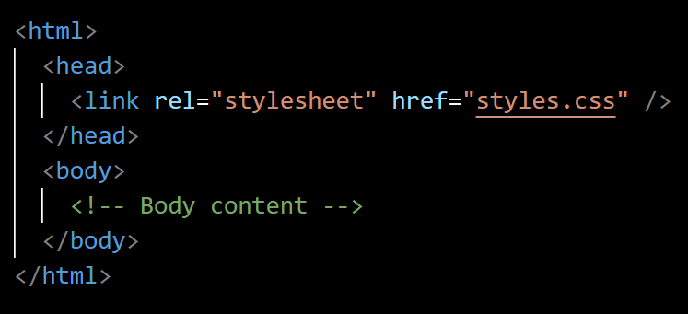
Q. How do you add an external stylesheet in your HTML?
<link> element is an empty element used to link external resources like stylesheets to the HTML document.
rel attribute specifies the relationship between the current document and the linked resource.
href attribute specifies the location (URL) of the external stylesheet.
back to chapter index

Slide 54
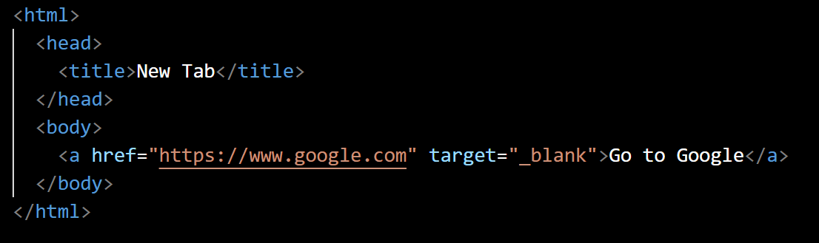
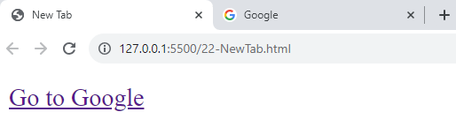
Q. How do you open a link in a new tab?
Target attribute specifies how the linked content should be displayed.
Target values: _blank(new tab), _self(default), _parent, _top
back to chapter index

Slide 55




Q. How do you create an Email Link?
Set the href attribute "mailto:" followed by the email address.
This will prompt the user's default email with the specified email address pre-filled in the "To" field. Else it will prompt for the other options.
back to chapter index

Slide 56
6. HTML Lists & Tables
Q. What are the different Types of Lists in HTML?
Q. What is a Nested List in HTML?
Q. What are table, tr, th, td elements? What are table advantages & disadvantages?
Q. What is the colspan attribute in HTML?
Q. What is the best way to add a border to a table, column and cell?
Back to main index

Slide 57


Q. What are the different Types of Lists in HTML?
Types of List
Ordered List
Unordered List
Description List
An ordered list is a list where the items are numbered or ordered in a specific sequence.
An unordered list is a list where the items are marked with bullets.
A description list is used to display a list of terms along with their corresponding descriptions or definitions.
back to chapter index

Slide 58


Q. What is a Nested List in HTML?
A nested list in HTML is a list that is placed within another list item.
back to chapter index

Slide 59






Q. What are table, tr, th, td elements? What are table advantages & disadvantages?
Table elements:
<table> is the container for the entire table.
<tr>(table row) is used to define a row in the table.
<th>(table header) is used to represent the column headers.
<td>(table data) is used to represent the regular cells in a table.
Tables are a powerful tool for styling and displaying structured data.
Tables multiple column's structure is not good for mobile devices(not responsive).
back to chapter index

Slide 60


Q. What is the colspan attribute in HTML?
The colspan attribute is used to merge multiple cells horizontally into a single cell.
colspan attribute is applicable to <th> and <td> only.
back to chapter index

Slide 61



Q. What is the best way to add a border to a table, column and cell?
Setting the common style for table, tr, th and td, then all the multiple tables in your webpage will follow consistent same style and format.
back to chapter index

Slide 62
7. HTML Images & Multimedia
Q. How to embed an Image in HTML? Why alt attribute is so important?
Q. What are the difference between JPEG & PNG image formats?
Q. How to embed Video element in HTML? Why we need multiple source elements?
Q. How to embed Audio element in HTML?
Q. What are the Autoplay & Loop attributes in multimedia elements?
Back to main index

Slide 63


Q. How to embed an Image in HTML? Why alt attribute is so important?
<img> element is used to embed an image in HTML.
The src(soruce) attribute specifies the source file of the image.
The alt(alternative text) attribute provides alternative text that describes the content of the image which is important for SEO(for searching).
back to chapter index

Slide 64

Q. What are the difference between JPEG and PNG image formats?
back to chapter index

Slide 65
Q. What are the difference between JPEG and PNG image formats?
JPEG | PNG
JPEG stands for Joint Photographic Experts Group. | PNG stands for Portable Network Graphics
2. JPEG uses lossy compression, which means some data is discarded to reduce image size. | PNG uses lossless compression, meaning no data is lost during compression.
3. Due to lossy compression, lower image quality. | Due to lossless compression, higher image quality.
4. Due to lossy compression, Image size is reduced. | Due to lossless compression, the image has a comparatively larger size.
back to chapter index

Slide 66


Q. How to embed Video in HTML? Why we need multiple source elements?
1
<video> is the element used to embed videos.
2
controls attribute adds video controls like play, pause & volume.
3
<source> element specifies multiple sources for the video. If one video format is not compatible with browser, then other will execute.
4
5
src attribute specifies the path to the video file.
type attribute indicates the MIME type.
6
The text "Your browser…" is a fallback message for browsers that do not support the <video> element.
back to chapter index

Slide 67


Q. How to embed Audio in HTML?
1
<audio> is the element used to embed audios.
2
controls attribute adds video controls like play, pause & volume.
3
<source> element specifies multiple sources for the audio. If one audio format is not compatible with browser, then other will execute.
4
5
src attribute specifies the path to the audio file.
type attribute indicates the MIME type.
6
The text "Your browser…" is a fallback message for browsers that do not support the <audio> element.
back to chapter index

Slide 68

Q. What are the Autoplay & Loop attributes in multimedia elements?
The autoplay attribute allows media content to start playing automatically as soon as the page is loaded.
The loop attribute, allows the media content to restart whenever it reaches the end.
back to chapter index

Slide 69
8. HTML Forms
Q. What are HTML Forms and what are its advantages?
Q. What are HTML Form Elements and their Main Attributes?
Q. How to Validate for empty input field in form?
Q. What is the role of the <textarea> element in a form?
Q. What are the Types of Input elements in a form?
Q. How to create radio buttons and checkboxes? How to group them?
Q. What is the purpose of the <select> element in a form?
Back to main index

Slide 70

Q. What are HTML Forms and what are its advantages?
Forms provide a way to collect and submit user data on a webpage.
Advantages of Form element
1. Data collection & organization is simple
2. Data validation is simple
3. Data submission on server is easy
4. Styling and Layout
5. Compatible with all browsers
back to chapter index

Slide 71

Q. What are HTML Form Elements and their Main Attributes?
Form elements & Attributes
1. form element
2. action attribute
3. method attribute
4. label element
6. input element
7. type attribute
8. name attribute
5. for attribute
back to chapter index

Slide 72
Q. What are HTML Form Elements and their Main Attributes?
Form elements and attributes
<form> element is the container of form elements.
The action attribute specifies the URL where the form data will be sent when it is submitted.
The method attribute defines the HTTP method to be used when sending the form data.
The <label> element is used to provide a label or description for an input field. The for attribute associate the label with a specific input field.
The <input> element is used to create controls.
The type attribute specifies the type of input field.
The name attribute is used to define a name for the input field.
back to chapter index

Slide 73


Q. How to Validate for empty input field in form?
required attribute is used to make the input filed mandatory.
back to chapter index

Slide 74


Q. What is the role of the <textarea> element in a form?
The <textarea> element is used in HTML forms to create a multi-line text input field.
rows attribute in textarea identify the number of lines in the text area.
cols attribute in textarea identify the number of characters in one row.
back to chapter index

Slide 75


Q. What are the Types of Input elements in a form?
Types of Input elements
Text Input
Password Input
File Input
Submit Button
Reset Button
Checkbox
Radio Button
Select
back to chapter index

Slide 76
Q. What are the Types of Input elements in a form?
Types of Input elements
Text Input
Password Input
File Input
Submit Button
Reset Button
Checkbox
Radio Button
Select
Text Input: Allows users to type alphanumeric characters. Commonly used for names, email addresses, passwords, etc.
Password Input: Masks the characters entered by the user, typically used for sensitive information like passwords.
File Input: Allows users to upload files.
Submit Button: Creates a button that submits the form data to a server for processing.
Reset Button: Creates a button that resets all the form fields back to their default values.
back to chapter index

Slide 77


Q. How to create radio buttons and checkboxes? How to group them?
Radio buttons are used when you want the user to select exactly one option from a group of options.
Checkboxes are used when you want the user to be able to select multiple options from a list.
All radio buttons or checkboxes within a group should share the same name attribute.
back to chapter index

Slide 78


Q. What is the purpose of the <select> element in a form?
The <select> element in HTML is used to create a dropdown menu within a form.
Dropdown menus are space-efficient compared to radio-buttons and checkboxes for displaying a long list of options.
back to chapter index

Slide 79
9. Best Practices, Boilerplate & Deployment
Q. What are Top 10 Best Practices for writing HTML code?
Q. What is HTML5 Boilerplate code?
Q. How do you optimize an HTML website for Performance?
Q. What is SEO? What are 5 HTML Best Practices for SEO?
Q. What are the 5 steps required for HTML website deployment?
Back to main index

Slide 80


Q. What are top 10 Best Practices for writing HTML code?
HTML Bad Practices
HTML Best Practices
back to chapter index

Slide 81
Q. What are top 10 Best Practices for writing HTML code?
HTML with best practices
7 Best practices for HTML:
Proper DocType declaration
Proper Meta Tags
Use Semantic Elements.
Give meaningful ID’s and class names.
Give Lowercase Element Names.
Alternative Text for Images by alt attribute.
Use of proper Header Elements.(h1,h2,h3,h4,h5,h6)
Use External CSS Link for styling.
Proper Indentation and Formatting for readability.
Always give title for the website page.
back to chapter index

Slide 82

Q. What is an HTML5 Boilerplate?
An HTML5 boilerplate is a basic template for building modern websites using HTML5.
back to chapter index

Slide 83

Q. How do you optimize an HTML website for Performance?
8 Best Practices for performance improvement in HTML:
Minimize HTTP Requests: Reduce the number of HTTP requests by combining CSS and JavaScript files.
Use External CSS and JavaScript Files
Minify CSS, JavaScript, and HTML: Remove unnecessary whitespace, comments & formatting to reduce file sizes.
Compress Images: Use tools to compress images and choose appropriate formats.
Leverage Browser Caching: Set cache headers to allow resources to be stored locally, reducing the need for repeated requests.
Load Critical Resources First.
Use Async and Await in JS.
Implement Lazy Loading to improve initial load times.
back to chapter index

Slide 84

Q. What is SEO? What are 5 HTML Best Practices for SEO?
5 HTML Best Practices for SEO
1. Use Semantic HTML Elements
2. Optimize Page Titles
3. Use Meta Description Tags
4. Use Proper Heading Tags
5. Optimize Image Alt Attributes
SEO(Search Engine Optimization) is the practice of optimizing a website to improve its visibility and ranking in search engine results.
back to chapter index

Slide 85
Q. What are the 5 steps required for HTML website deployment?
5 Basic Steps for HTML website deployment:
1
2
3
4
5
Purchase a Domain (ex: www.interviewhappy.com)
Prepare Your Website Files(ex: HTML/ CSS/ JS/ Image)
Upload Files to Hosting Server(using FTP, hosting panel, GIT)
Configure SSL (Optional - Enable SSL for using HTTPS and enhance security)
Choose a Hosting Provider (ex: aws/ azure)
back to chapter index

Slide 86
10. HTML Responsiveness, Frameworks & Others
Q. What is Responsive Design?
Q. What are the top 3 things required to make a website Responsive in HTML?
Q. What are some Responsive Design Frameworks for HTML & CSS?
Q. What are HTML Entities? How do you display special characters in HTML?
Q. What are the Top 5 Emerging Trends in HTML development?
Back to main index

Slide 87




Q. What is Responsive Design?
Responsive design is a practice of creating web pages that adapt and display well on various devices and screen sizes.
back to chapter index

Slide 88


Q. What are the top 3 things required to make a website Responsive in HTML?
Set the Viewport Meta Tag : This tag tells the browser to adjust the width of the page to match the screen's width.
Use Relative Units: Instead of using fixed units like pixels, use relative units like percentages
Media Queries: They set different sizes for different screen types.
back to chapter index

Slide 89
Q. What are some Responsive Design Frameworks for HTML & CSS?
Responsive Design Frameworks
1. Bootstrap
2. Foundation
3.
Bulma
4. Semantic UI
5. Materialize
6.
Tailwind CSS
back to chapter index

Slide 90


Q. What are HTML Entities? How do you display special characters in HTML?
HTML entities are special codes or sequences of characters used to represent reserved or special characters in HTML.
back to chapter index

Slide 91

Q. What are the Top 5 Emerging Trends in HTML development?
1. Web Components:
2. Progressive Web Apps (PWAs)
3. Single Page Applications (SPAs):
4. 3D Graphics and Virtual Reality (VR)
5. Augmented Reality (AR):
Web Components are a set of web platform APIs that allow you to create custom, reusable HTML elements.
PWAs are web applications that provide a native app-like experience to users.
SPAs load a single HTML page and dynamically update content as the user interacts with the app.
VR refers to the integration of virtual reality experiences within a web browser using HTML, CSS, and JS. Example: WebGL & WebVR.
AR combines the physical world with digital information or content. Example: ARCore and ARKit for web development.
back to chapter index

Slide 92
1. CSS Basics & Implementation
Q. What is CSS? What are the 5 ways to Implement CSS in HTML?
Q. What is Inline Style in CSS? When to use it in real applications?
Q. What is Internal Stylesheet in CSS? When to use it in real applications?
Q. What is External Stylesheet in CSS? When to use it in real applications?
Q. What are the 5 advantages of external stylesheet?
Q. How do you Include CSS in a webpage or HTML?
Q. How to implement CSS using @import rule?
Q. What is CSS Preprocessors? What is SCSS?
Q. What are the 3 Types of CSS Preprocessors?
Back to main index

Slide 93


Q. What is CSS? What are the 5 ways to Implement CSS in HTML?
CSS(Cascading Style Sheets) is a stylesheet language used to control the presentation of web pages.
HTML (Markup Language)
JavaScript
(Scripting/ Programming Language)
CSS (Stylesheet Language)
CSS
back to chapter index

Slide 94
Q. What is CSS? What are the 5 ways to Implement CSS in HTML?
1. Inline Styles
2. Internal Style Sheet
3. External Stylesheet
4. @import Rule
5. CSS Preprocessors
5 Ways of implementing CSS in HTML
back to chapter index

Slide 95

Q. What is Inline Style in CSS? When to use it in real applications?
Inline Styles apply styles directly to individual HTML elements using the style attribute.
This method is suitable for applying styles to a single element.
5 Ways of implementing CSS in HTML
1. Inline Styles
2. Internal Style Sheet
3. External Stylesheet
4. @import Rule
5. CSS Preprocessors
back to chapter index

Slide 96

Q. What is Internal Stylesheet in CSS? When to use it in real applications?
Internal Style Sheets can be implemented by adding the <style> element in the <head> section of HTML.
This method is suitable for smaller projects.
5 Ways of implementing CSS in HTML
1. Inline Styles
2. Internal Style Sheet
3. External Stylesheet
4. @import Rule
5. CSS Preprocessors
back to chapter index

Slide 97


Q. What is External Stylesheet in CSS? When to use it in real applications?
In External Stylesheet, a separate CSS file is created(.css extension) and link it in the HTML file using the <link> element.
This is most common and recommended.
5 Ways of implementing CSS in HTML
1. Inline Styles
2. Internal Style Sheet
3. External Stylesheet
4. @import Rule
5. CSS Preprocessors
back to chapter index

Slide 98

Q. What are the 5 advantages of External Stylesheet?
5 Advantages of CSS:
1. Separation of content(HTML) and presentation(Style).
2. Reusability of CSS classes in multiple elements.
3. Keeps things organized and structured.
4. Adapts to Different Devices.
5. Improves Website Speed.
back to chapter index

Slide 99


Q. How do you Include CSS in a webpage or HTML?
1. External Stylesheet: By using the <link> element in the <head> section of the HTML document.
2. Internal Style Sheet: By using the <style> element in the <head> section.
3. Inline Styles: Apply styles directly to individual HTML elements using the style attribute.
back to chapter index

Slide 100



Q. How to implement CSS using @import rule?
@import rule is to include external CSS file to main CSS file.
This method is less commonly used due to potential performance issues.
5 Ways of implementing CSS in HTML
1. Inline Styles
2. Internal Style Sheet
3. External Stylesheet
4. @import Rule
5. CSS Preprocessors
back to chapter index

Slide 101


Q. What is CSS Preprocessors? What is SCSS?
CSS preprocessors are scripting languages that provide additional syntax and features that are not available in traditional CSS. For example, variables, loops, and conditional statements.
SCSS is a type of CSS preprocessor.
back to chapter index

Slide 102
Q. What are the 3 Types of CSS Preprocessors?
3 Types of CSS Preprocessors
1. SCSS/ SASS
(Sassy CSS/ (Syntactically Awesome Stylesheets)
File extension: .scss
3. LESS
File extension: .less
4. Stylus
File extension: .styl
back to chapter index

Slide 103
2. Selectors in CSS
Q. What are Selectors in CSS? How many types of selectors are there?
Q. Difference between ID, Element & Class selector? When to use which selector?
Q. What are Universal selectors?
Q. What are the Descendant Selectors in CSS?
Q. What are Attribute Selectors in CSS? What are it’s 5 Types?
Q. What are Child Selectors in CSS?
Q. How Child Selector is different from Descendent selectors?
Q. What are Pseudo-class Selector & Pseudo-element Selector?
Back to main index

Slide 104
Q. What are Selectors in CSS? How many Types of selectors are there?
In CSS, selectors are patterns that are used to select and style HTML elements.
Types of Selectors
1. ID Selector(#)
2. Element Selector(no symbol)
3. Class Selector(.)
4. Universal Selector(*)
5. Descendant selector
6. Child Selector(>)
back to chapter index

Slide 105





Q. Difference between ID, Element & Class selector? When to use which selector?
back to chapter index

Slide 106
Q. Difference between ID, Element & Class selector? When to use which selector?
1. ID Selector (#)
ID selectors are used for unique elements on a page, and they should only be assigned to one element.
2. Element Selector
Element selectors are used when you want to apply a style to all elements of a specific type.
3. Class Selector (.)
Class selectors are used when you want to apply a style to multiple elements with the same class.
back to chapter index

Slide 107



Q. What are Universal selectors?
Universal selector applied the specified styles to all elements, regardless of their type or attributes.
back to chapter index

Slide 108



Q. What are the Descendant Selectors in CSS?
A descendant selector in CSS is a selector that targets an element that is a descendant of another specified element(nested elements).
back to chapter index

Slide 109


Q. What are Attribute Selectors in CSS? What are it’s 5 Types?
Attribute selectors in CSS target HTML elements based on their attributes and their values.
back to chapter index

Slide 110



Q. What are Child Selectors in CSS?
A child selector targets an element that is a immediate child of specified parent element.
It's denoted by the > symbol.
back to chapter index

Slide 111
Q. How Child Selector is different from Descendant selectors?
The child selector targets immediate children, while the descendant selector targets all descendants, regardless of depth.
back to chapter index

Slide 112



Q. What are Pseudo-class Selector and Pseudo-element Selector?
A pseudo-class selector is used to define the special state of an HTML element, like when a user hovers over an element.
A pseudo-element selector targets a specific part of an element, such as ::before to insert content before an element.
back to chapter index

Slide 113
3. Layout and Positioning
Q. Explain the concept of the Box Model in CSS.
Q. What is the difference between Padding & Margin?
Q. What is the difference between display: inline & display: block?
Q. What is the difference between display: inline & display: inlineblock?
Q. What is z-index property in CSS? How same z-index elements will be displayed?
Q. What is the role of float property in CSS?
Q. What is the difference between position: relative/ absolute/ fixed?
Back to main index

Slide 114



Q. Explain the concept of the Box Model in CSS.
The "box model" describes the layout of elements on a webpage in terms of their dimensions and spacing.
Content: This is the actual content of the element, such as text, images, videos, etc.
Padding: This is the space between the content and the border.
Border: This is the line that separate the content from the surrounding elements.
Margin: This is the space between the borders of adjacent elements. Margins help control the space between elements.
Without box model
In CSS, you can control each of these components using various properties like width, height, padding border, margin.
With box model
back to chapter index

Slide 115

Q. What is the difference between Padding and Margin?
Element Border
Padding is the space between the content of an element and its border.
Margin is the space outside an element, between the element and its surrounding elements.
Element 1
Content/ Text
Padding
Margin
Element 2
Margin
Content/ Text
Padding
back to chapter index

Slide 116



Q. What is the difference between display: inline & display: block?
Block elements take up the full width of their parent container by default
Inline elements take up as much width as per the width of content only.
back to chapter index

Slide 117



Q. What is the difference between display: inline and display: inlineblock?
Inline elements do not accept width and height values whereas inline-block accept width and height also.
back to chapter index

Slide 118



Q. What is z-index property in CSS? How same z-index elements will be displayed?
z-index property in CSS is used to control the stacking order of positioned elements.
Elements with a higher z-index value will be displayed on top of elements with a lower z-index value.
If two elements have the same z-index, the one that comes later in the HTML source will appear on top.
back to chapter index

Slide 119



Q. What is the role of float property in CSS?
The float property in CSS is used to specify how an element should align or "float" within its parent container.
back to chapter index

Slide 120



Q. What is the difference between position: relative/ absolute/ fixed?
position: relative positions an element relative to its normal position of the page.
position: absolute is positioned as per the parent element.
position: fixed will fix the position of element even if the page is scrolled.
back to chapter index

Slide 121
4. Responsive Design, Flexbox & Grid Layout
Q. What is the role of meta viewport tag?
Q. What are Media Queries in CSS?
Q. What is display: flex in CSS?
Q. What is CSS Grid Layout in CSS?
Q. How can you create a Sticky Header in CSS?
Q. What are the 5 best practices for creating a Responsive Design using CSS?
Back to main index

Slide 122
Q. What is the role of meta viewport tag?
In web design, the "viewport" is the portion of the webpage that the user can see on their screen at any given time, without scrolling.
Viewport
Viewport
Viewport
back to chapter index

Slide 123

Q. What is the role of meta viewport tag?
The <meta name="viewport"> tag in HTML is used to adjust the webpage on different devices and screen sizes.
Name attribute specifies that the meta tag is a meta viewport.
Content width property tells the browser to set the width of the viewport to the width of the device's screen.
Content initial-scale property sets the initial zoom level when the page is first loaded. A value of 1.0 means that the page is displayed at its actual size without any zooming.
back to chapter index

Slide 124




Q. What are Media Queries in CSS?
Media queries in CSS allows you to apply different styles to elements based on the size of device screen.
back to chapter index

Slide 125





Q. What is display: flex in CSS?
display:flex turns an element into a container that structure and align its child elements in a better way. It enables a flexbox layout for the container.
justify-content property aligns flex items along the main axis of the flex container. It controls the spacing between and around items.
back to chapter index

Slide 126




Q. What is CSS Grid Layout in CSS?
Without grid css
The CSS Grid Layout Module offers a grid-based layout system, with rows and columns.
With grid css
back to chapter index

Slide 127


Q. How can you create a Sticky Header in CSS?
Position: fixed can be used to implement sticky header in CSS.
back to chapter index

Slide 128

Q. What are the 5 best practices for creating a Responsive Design using CSS?
5 Best practices for creating responsive design
1. Use Responsive Units(%)
2. Use Media Queries
3. Flexible Layout
4. Images and Media size
5. Viewport Meta Tag
back to chapter index

Slide 129
Q. What are the 5 best practices for creating a Responsive Design using CSS?
1. Use Responsive Units:
Use relative units like percentages (%) or em units for sizes (width, height, padding, margin, etc.) instead of fixed units like pixels (px).
2. Use Media Queries:
Media queries allow you to apply different styles based on the characteristics of the device, such as screen width, height, and orientation. They are essential for creating a responsive design.
3. Flexible Grid Systems:
Use CSS Grid or Flexbox to create flexible layouts that can adapt to different screen sizes and orientations.
4. Images and Media:
Use max-width: 100%; on images to ensure they don't overflow their containers. This allows images to scale down proportionally on smaller screens.
5. Viewport Meta Tag:
Include the viewport meta tag in the <head> of your HTML to control how the page is displayed on mobile devices. It sets the initial scale, width, and zoom behavior.
back to chapter index

Slide 130
1. Bootstrap
Q. What is Bootstrap? What are the other 5 responsive design frameworks?
Q. What are the 5 Advantages of using Bootstrap?
Q. What are the 2 ways to include Bootstrap framework for your website.
Q. Explain the Grid System in Bootstrap?
Q. What is the difference between col-xs, col-sm, col-md, col-lg & col-xl?
Q. What are Bootstrap Components? What are Top 10 bootstrap components?
Q. What is a Bootstrap Modal component?
Q. What is a Bootstrap Navigation component?
Q. What is Bootstrap Carousel component?
Q. Explain the difference between Bootstrap's container & container-fluid?
Back to main index

Slide 131
Q. What is Bootstrap? What are the other 5 responsive design frameworks?
Bootstrap is a popular open-source front-end framework which provides responsive and mobile-first CSS.
back to chapter index

Slide 132
Q. What is Bootstrap? What are the other 5 responsive design frameworks?
All Responsive Design Frameworks
1. Bootstrap
2. Foundation
3.
Bulma
4. Semantic UI
5. Materialize
6.
Tailwind CSS
back to chapter index

Slide 133
Q. What are the 5 Advantages of using Bootstrap?
1. Rapid Development
Bootstrap provides a wide range of ready-to-use components like navigation bars, buttons, forms, modals, and more. This saves time and effort in writing code from scratch.
2. Responsive Design
Bootstrap is built with a mobile-first approach, meaning it prioritizes designing for smaller screens first and then scales up for larger screens. This ensures websites with Bootstrap is responsive for every device.
5. Accessibility
3. Cross-Browser Compatibility
4. Large Community and Support
Bootstrap provides a consistent set of styles and components across different browsers, which helps in reducing cross-browser compatibility issues.
This means there are plenty of resources, documentation, tutorials, and forums available for assistance.
Bootstrap incorporates best practices for web accessibility, making it easier to create websites that are usable by people with disabilities.
back to chapter index

Slide 134

Q. What are the 2 ways to include Bootstrap framework for your website.
2 ways to include Bootstrap:
1. Put the link of Bootstrap CDN (Content Delivery Network) in head section.
2. Download the Bootstrap files and add them locally in your HTML document.
back to chapter index

Slide 135
Q. Explain the Grid System in Bootstrap?
Grid system is 12-column layout and is designed to adapt to various screen sizes.
col-1 | col-2 | col-3 | col-4 | col-5 | col-6 | col-7 | col-8 | col-9 | cool-10 | col-11 | col-12
col-1 |  | col-2 |  | col-3 |  | col-4 |  | col-5 |  | col-6
col-1 |  |  | col-2 |  |  | col-3 |  |  | col-4
col-1 |  |  |  | col-2 |  |  |  | col-3
col-1 |  |  |  |  |  | col-2
col-1
back to chapter index

Slide 136



Q. Explain the Grid System in Bootstrap?
back to chapter index

Slide 137



Q. What is the difference between col-xs, col-sm, col-md, col-lg & col-xl?
col-xs (Extra Small): Applies to extra small screens (phones).
col-sm (Small): Applies to small screens (tablets).
col-md (Medium): Applies to medium screens (laptops).
col-lg (Large): Applies to large screens (larger desktops).
col-xl (Extra Large): Applies to extra large screens (large TVs).
back to chapter index

Slide 138




Q. What are Bootstrap Components? What are Top 10 bootstrap components?
1. Buttons
2. Navbar
3. Forms
Top 10 Bootstrap components
4. Carousel
5. Cards
7. Pagination
8. Spinners
9. Badges
10. Modals
6. Progress Bars
Bootstrap components are pre-designed elements that can be easily integrated into a web project.
back to chapter index

Slide 139




Q. What are Bootstrap Components? What are Top 10 bootstrap components?
1. Buttons
2. Navbar
3. Forms
Top 10 Bootstrap components
4. Carousel
5. Cards
7. Pagination
8. Spinners
9. Badges
10. Modals
6. Progress Bars
Bootstrap components are pre-designed elements that can be easily integrated into a web project.
back to chapter index

Slide 140


Q. What is a Bootstrap Modal component?
A Bootstrap modal is a lightweight, customizable, and interactive dialog box or popup window that appears on top of the main content of a web page.
back to chapter index

Slide 141


Q. What is a Bootstrap Navigation component?
Bootstrap's Navigation component provides a set of styles and components to create various types of navigation menus on a webpage.
back to chapter index

Slide 142

Q. What is Bootstrap Carousel component?
Bootstrap's carousel component is a slideshow or image slider that allows you to display a series of images or content in a rotating manner.
back to chapter index

Slide 143




Q. Explain the difference between Bootstrap's container and container-fluid?
.container class centered the content and add padding to the sides, ensuring that the content remains within a specified width.
.container-fluid class provides a full-width layout, with the content extending to the edges of the screen.
back to chapter index

Slide 144

All the best for your interviews Never ever give up

